Slide 1
Setting Over Current Relays on ETAP
Objectives:
To learn settings of definite time over current relays on ETAP
System used:
IEEE 4 Bus System

Slide 2
Starting with the IEEE 4 bus system…
The additional data required in this network is grid SC MVA, which is set to 100 MVA, with X/R 17
Remove transformer from section 2 – 3 and copy line 1 in its place
Modify the load connected at bus 4 to 100 % static and 1730 kVA
Add static loads to bus 3 and 2 of 3460 and 4300 kVA respectively

Slide 3
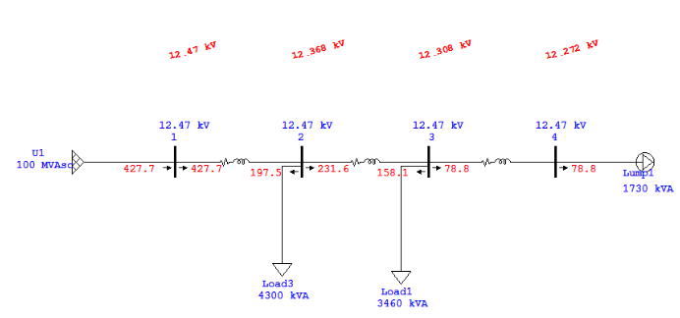
Run Load Flow Analysis & Note line current for all sections

Slide 4
Run short circuit analysis:
For 3 phase fault , L-G, L-L and DLG faults & Note maximum and minimum fault currents for each bus

Slide 5
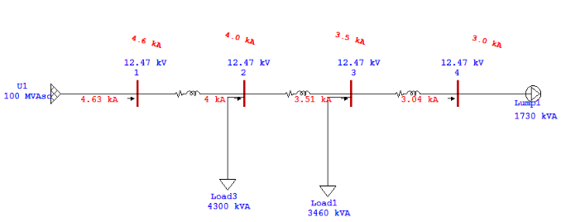
3 phase fault

Slide 6
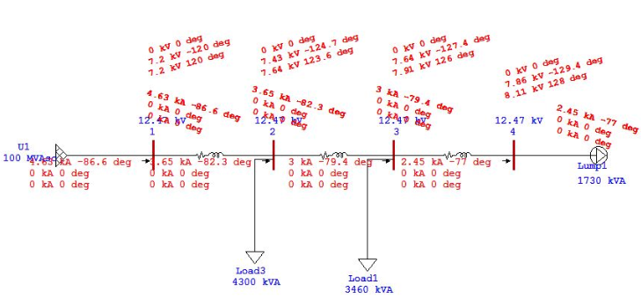
L-G Fault

Slide 7
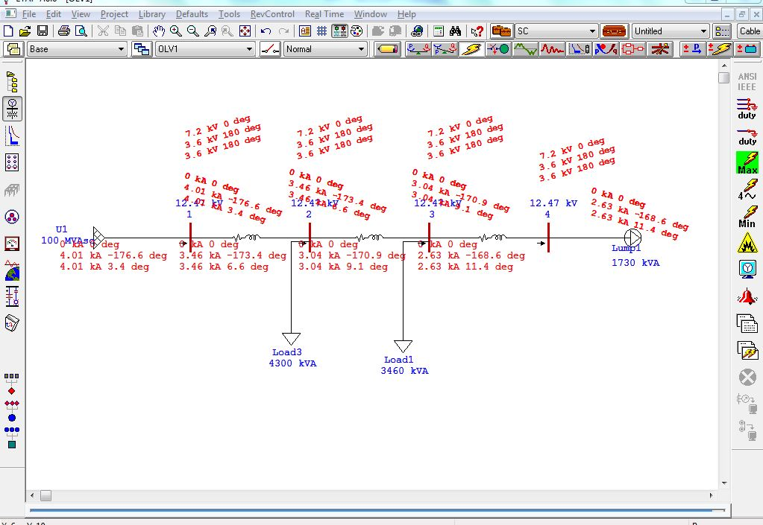
Line-Line Fault

Slide 8
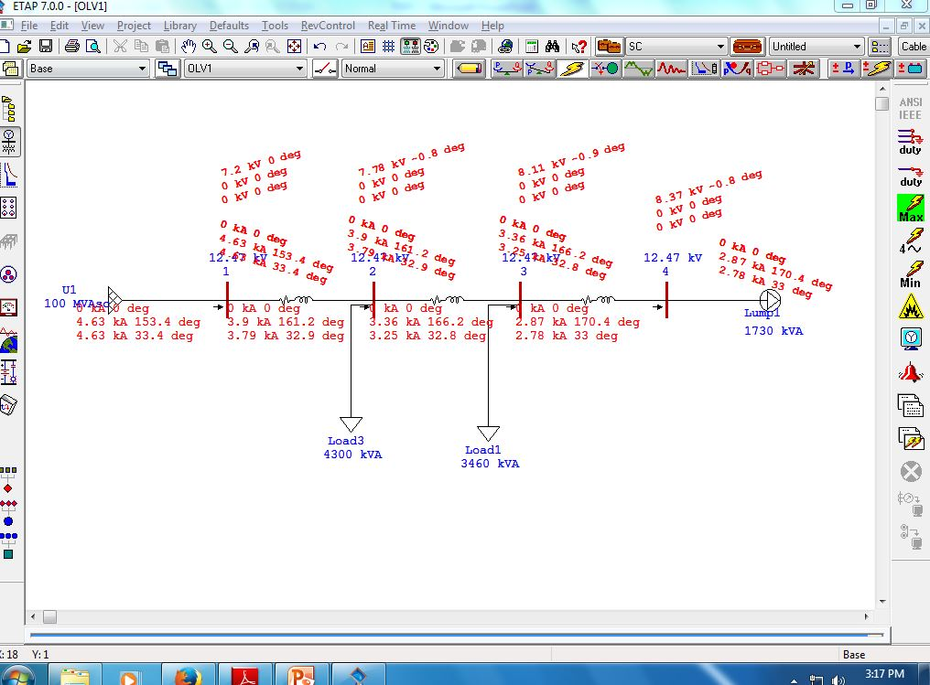
DLG Fault

Slide 9
Findings from Fault Analysis
Bus No | 1 | 2 | 3 | 4
Normal (A) | 427 | 427 | 232 | 79
Max If (A) | 4630 | 4000 | 3500 | 3000
Min If (A) | 4010 | 3460 | 3000 | 2450

Slide 10
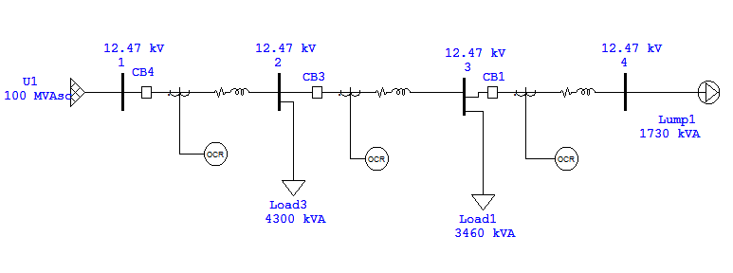
Placement of Relays and Circuit Breakers in all line sections for Over Current Protection
HV Circuit Breaker
CT
Over current Relay

Slide 11
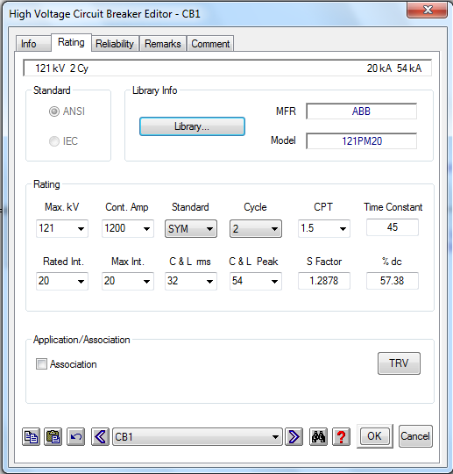
Circuit Breaker Ratings
Select a CB from Library, keeping in mind the interrupting capacity required.

Slide 12
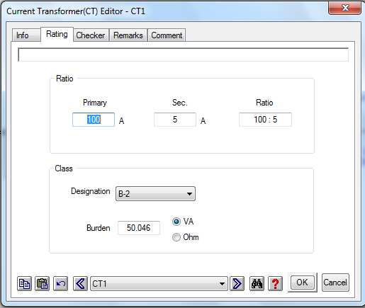
Current Transformer Ratings
Select appropriate turns ratio for CT keeping in mind the primary current in line where CT is connected. You can also select CT Burden class.

Slide 13
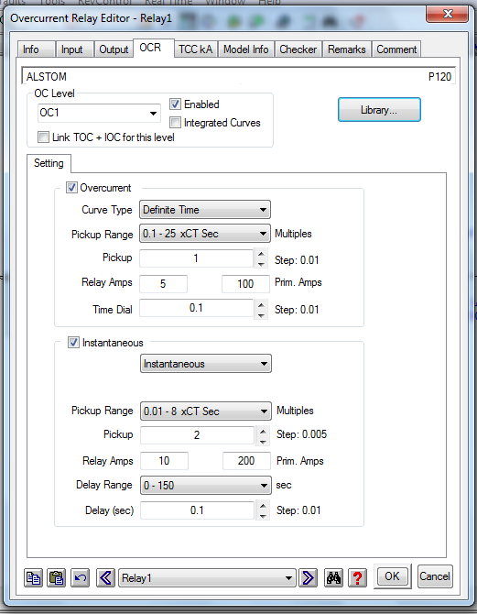
Over Current Relay Parameters
Select an over current relay from a library of different models and manufacturers of OCR.

Slide 14
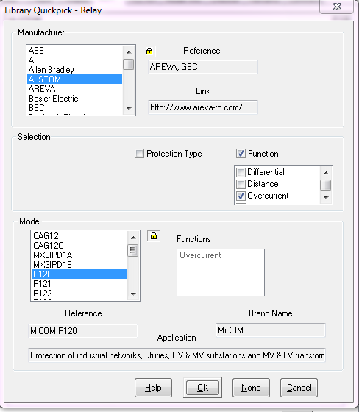
For example, select Alstom P120.
To observe definite time characteristic, uncheck the instantaneous option.

Slide 15
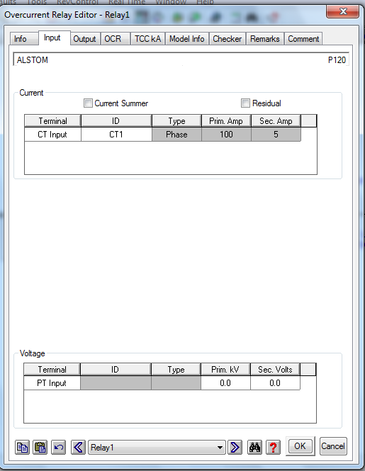
Connect CT with respective OCR and verify its turns ratio from Input Tab of Relay.

Slide 16
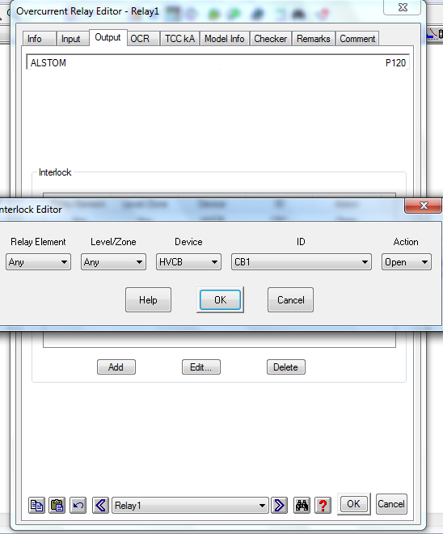
In output Tab of Relay Editor , Add one HV CB to which the relay should send its output.

Slide 17
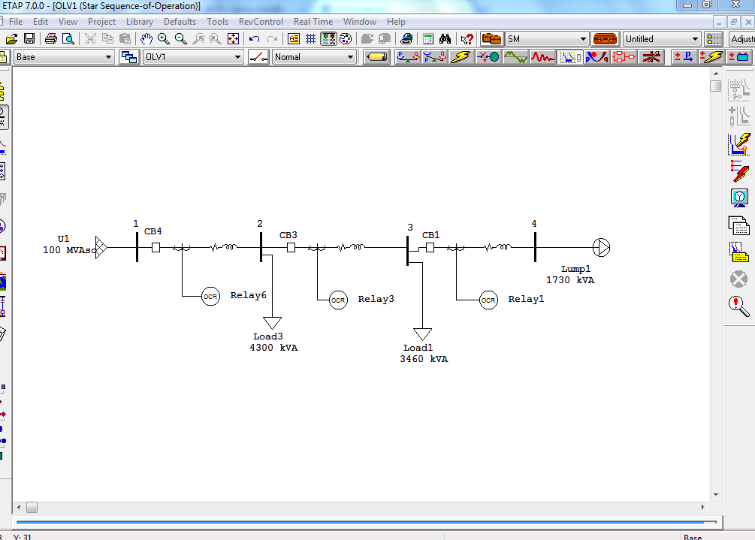
Drag and Drop “Fault insertion” to any bus that you want to fault
Star Protective Device Coordination

Slide 18
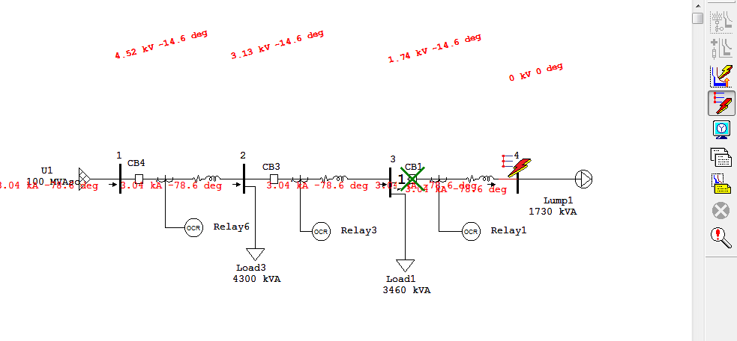
The Circuit Breaker 1 operates (indicated by a cross) when fault is placed on bus 4.

